Slide 1

Periods in NeuroPlasticity: pedals or brakes?
Dan Ofer

Slide 2
Neuroplasticity & Development
Experience dependence
“Periods”
Stability & Plasticity
How Stability is Maintained
Brains over time
Experiments & Findings
The Answer is…
Pedals or Brakes?

Slide 3



The Early brain:
Young | Old
Learning is Easy | Learning is HARD!
Totally new abilities acquired (walking, talking..) | No new “tricks”.
Most neural activity is Excitatory* | Most neural cell-cell messages are Inhibitory
* Bavelier, & Hensch et al.. (2010). Removing brakes on adult
brain plasticity: From molecular to behavioral interventions. Journal of Neuroscience,

Slide 4
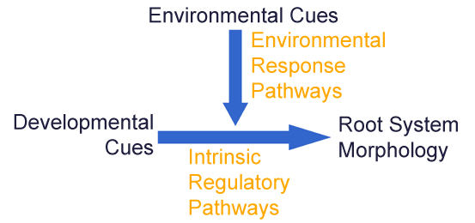

Experience and Neurodevelopment
Experience Dependent Plasticity ~ Environmental input modulates.
Doesn’t apply for all cortical circuits!
Different types, circuits, periods.
Depends on organism, even for the same senses ..
-> Let’s Talk Time!

Slide 5
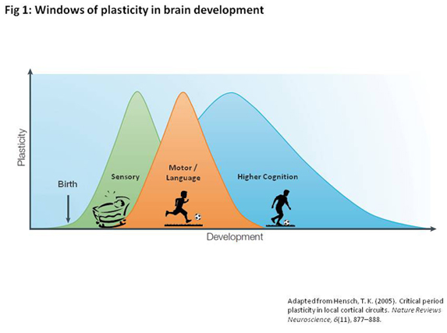
Sensitive periods
Periods of increased sensitivity during development.
Effects of experience are enhanced.
Quantitative Difference
Notes:
(Second) Language. Skills. Social normas & behavior

Slide 6


Sensitive periods (II)
Languages
Social Norms & behavior
$0−6+ Y$ears
$2.5 Y$ears +
LeBlanc JJ, Fagiolini M. Autism: a "critical period" disorder? Neural Plast. 2011
Montessori, Maria (1949). The Absorbent Mind

Slide 7

Critical periods
A strict time window during which environmental experience provides information essential for a function’s development and “fixates” it, permanently.
Qualitative Difference
CRITICAL PERIOD PLASTICITY IN LOCAL CORTICAL CIRCUITS. Hensch. NATURE REVIEWS NEUROSCIENCE. (2005)

Slide 8
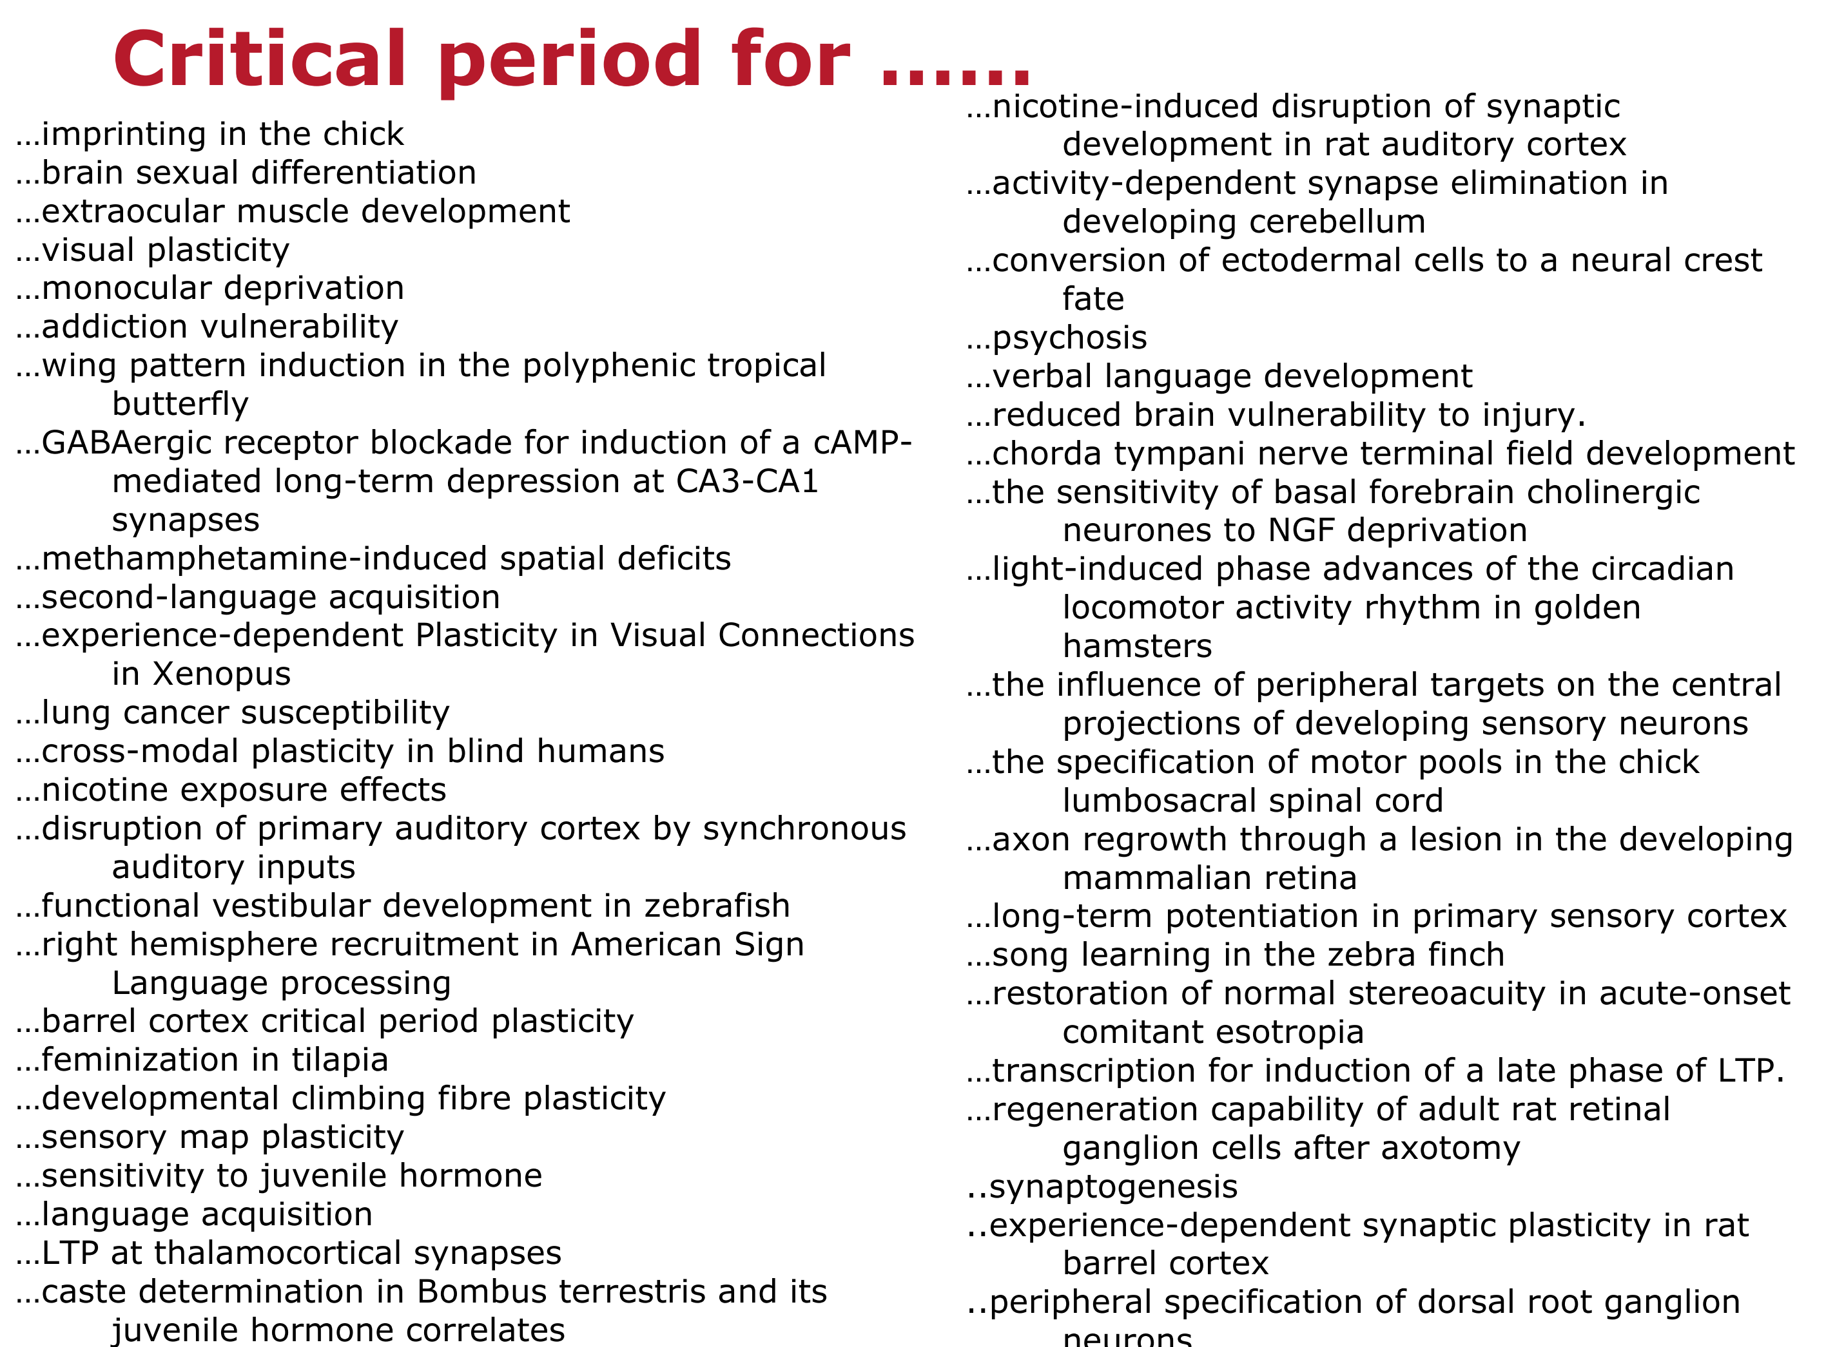

Slide 9


Critical period: Parental Imprinting

Slide 10
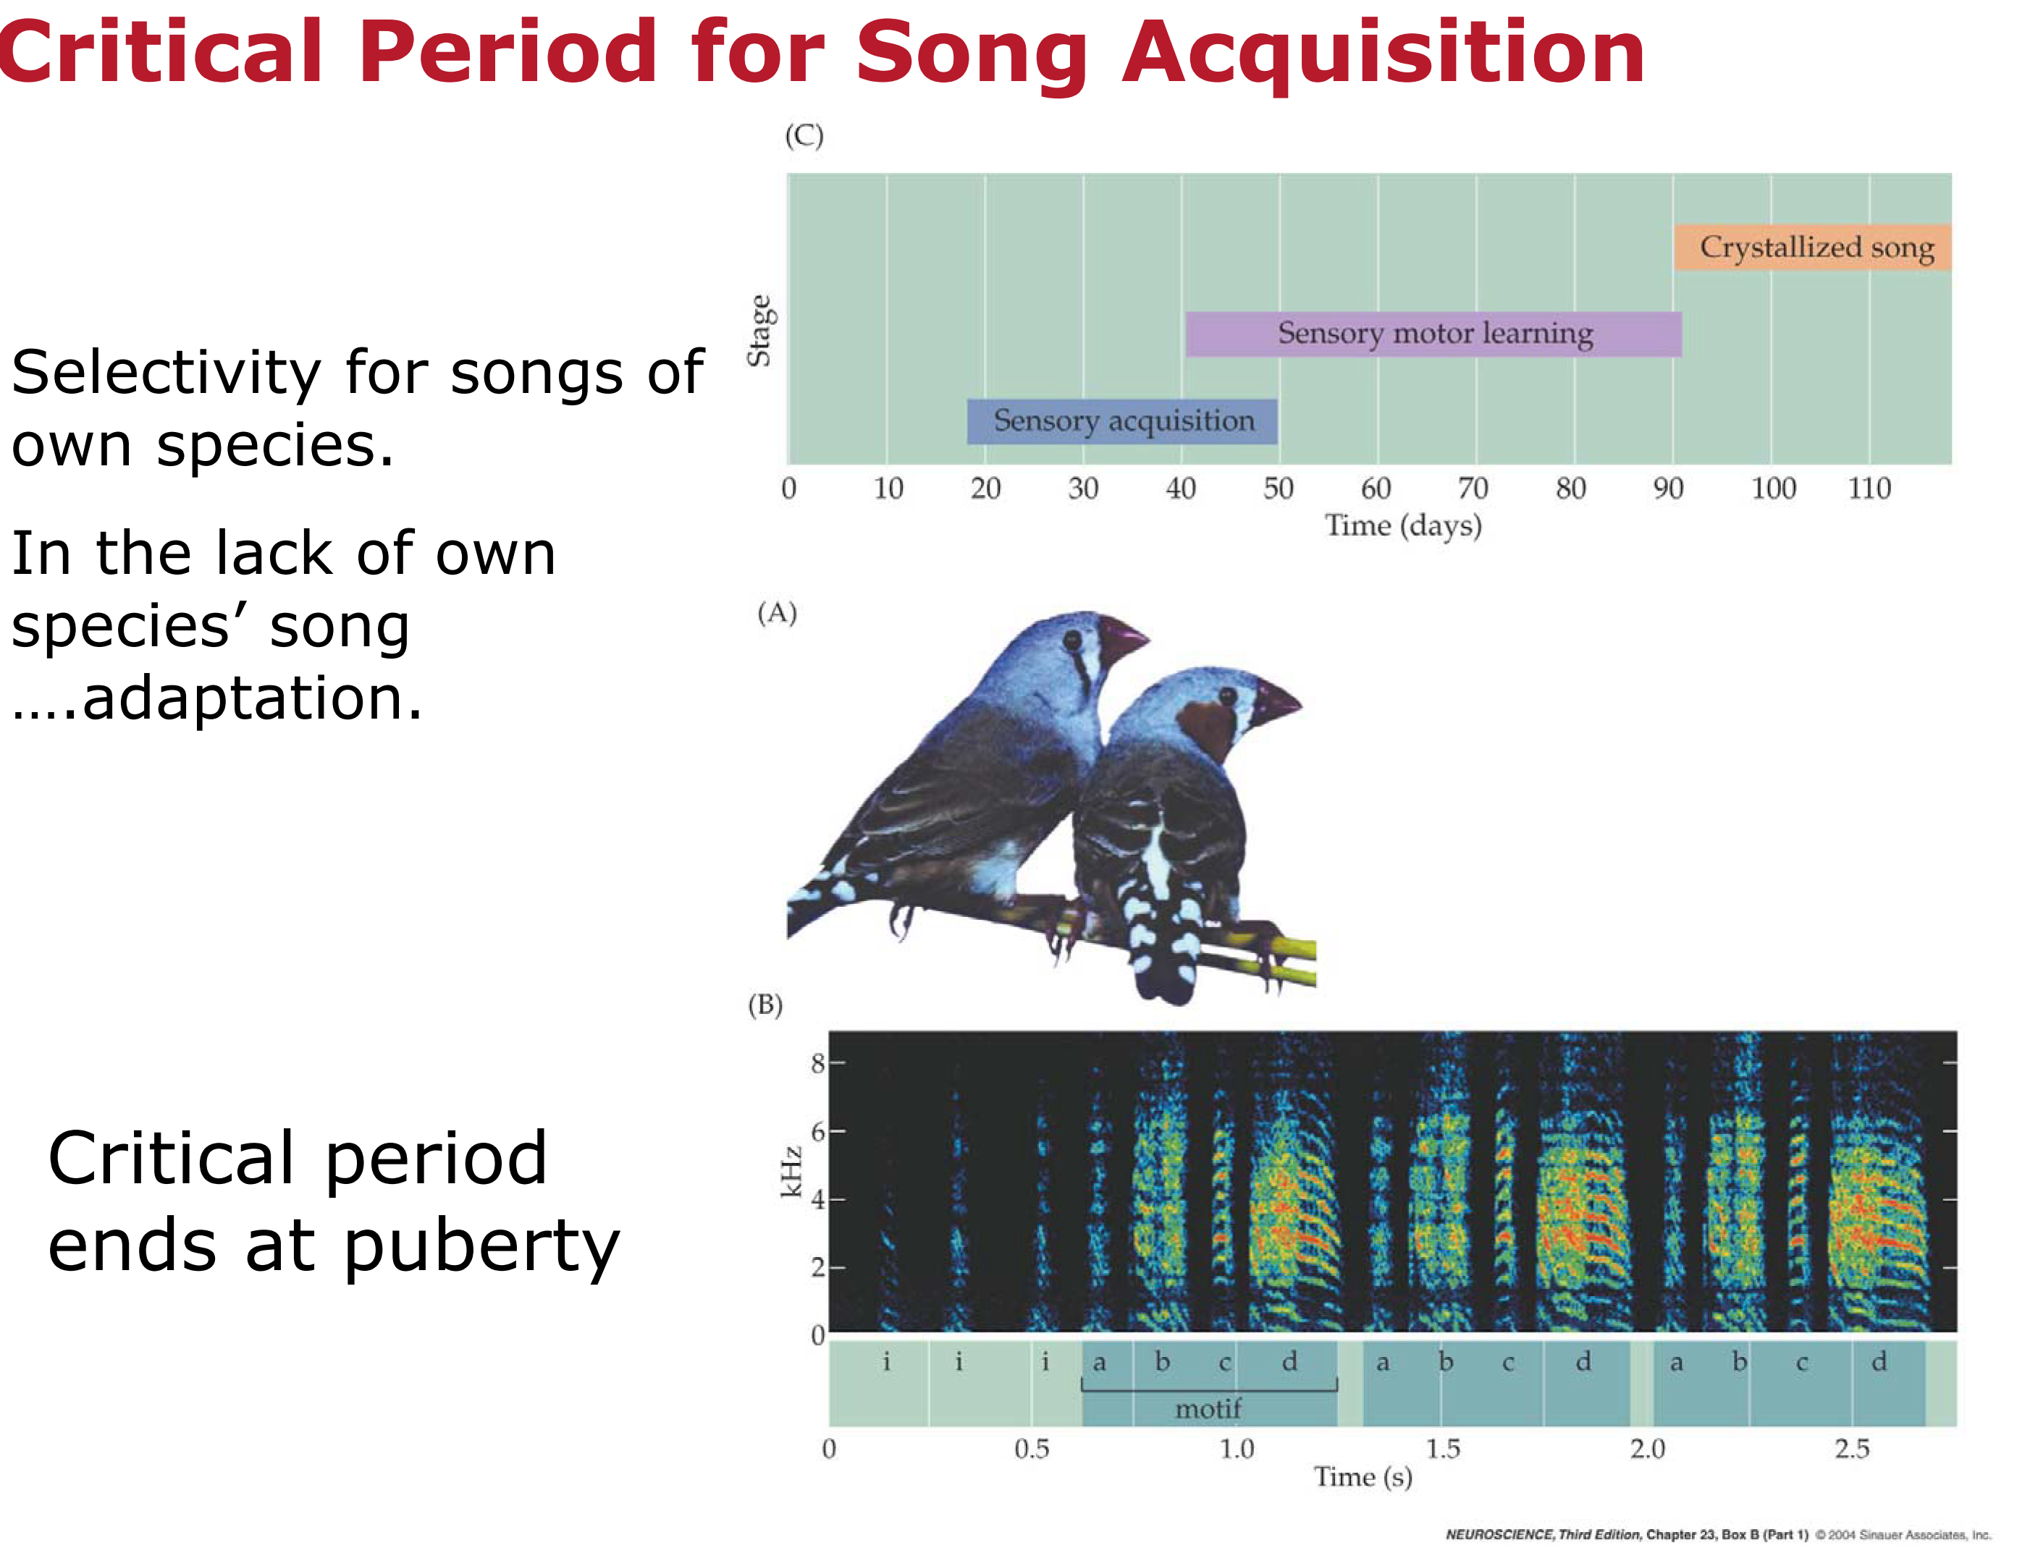

Slide 11


Critical period: ocular dominance monocular deprivation
Hubel & Wiesel.
Showed that ocular deprivation during CP causes monocular dominance, Ambylopia.
Only during critical period.
Common experimental system for critical period in visual system.
Wiesel, Hubel (1963). "Effects of visual deprivation on morphology and physiology of cell in the cat's lateral geniculate body". Journal of Neurophysiology

Slide 12
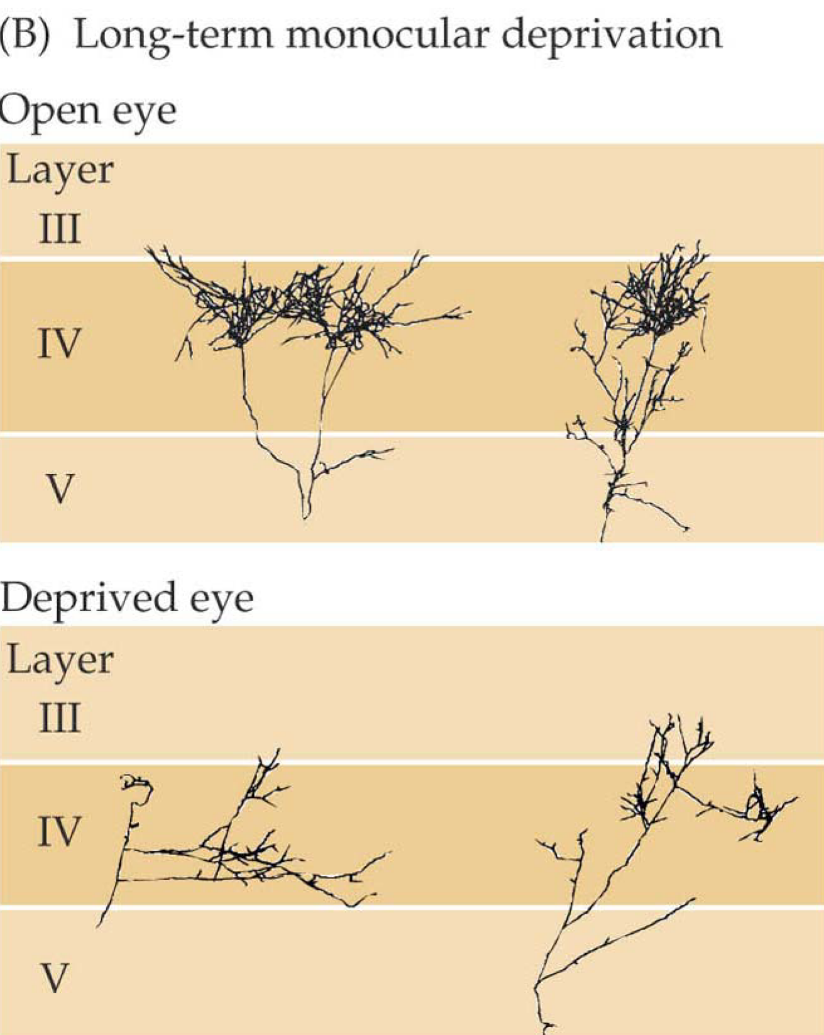
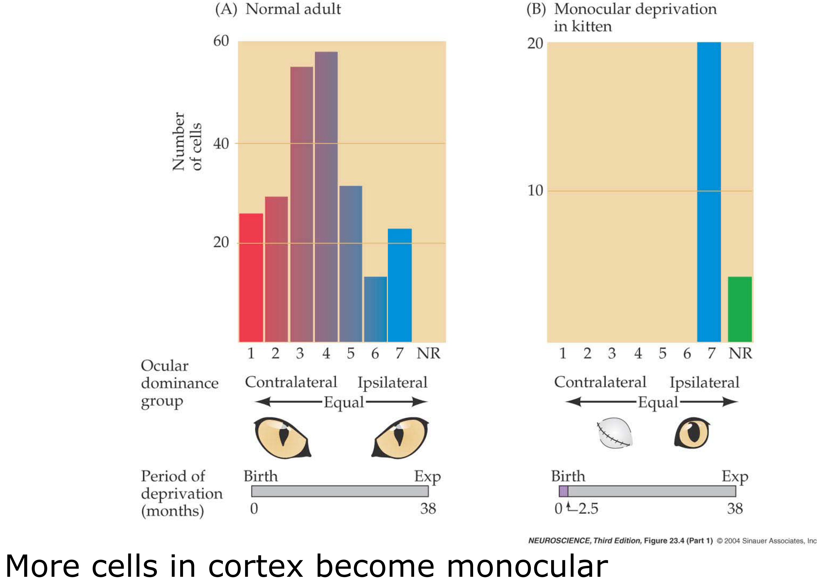
Critical period: ocular dominance

Slide 13
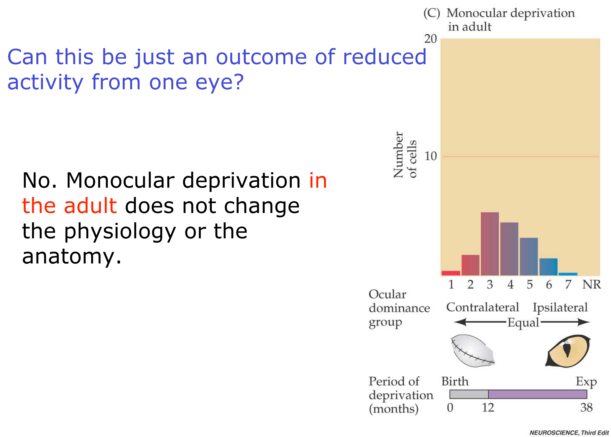
Critical period: ocular dominance
Only during critical period.
Common experimental system (for critical period).
Critical period

Slide 14
Neuroplasticity & Development
Experience dependence
“Periods”
Stability & Plasticity
How Stability is Maintained
Brains over time
Experiments & Findings
The Answer is…:
Pedals or Brakes?

Slide 15
Questions:
What is the “default” state of plasticity in the brain?
Plastic or stable?
What are the factors that control or regulate cortical plasticity?
State “maintenance”.
Switching between states.
Could we make adult brains pliable & plastic?

Slide 16
(I) Structural Stabilization:
Myelinization
Glia, Astrocytes
Perineuronal nets. Parvalbumin Interneurons
Experience-driven plasticity of visual cortex limited by myelin and Nogo receptor. Science. (2005).
Bavelier, Hensch, et’. Removing Brakes on Adult Brain Plasticity: From Molecular to Behavioral Interventions. J. Neuroscience (2010).
Bardin, J. Neurodevelopment: unlocking the brain. Nature 487, 24–6 (2012).
Hensch. Critical period plasticity in local cortical circuits. Nat. Rev. Neurosci. (2005).

Slide 17
(II) Functional Stabilization:
$$\frac{Excitation}{Inhibiton}$$
Excitation/Inhibiton
GABA
LYNX1
More:
HDAC..
Inhibitory.
Required for Crit. P!
Notes:
(GABA), chief inhibitory neurotransmitter
Ach - acetylcholine. HDAC – Histone-Deacetylase

Slide 18
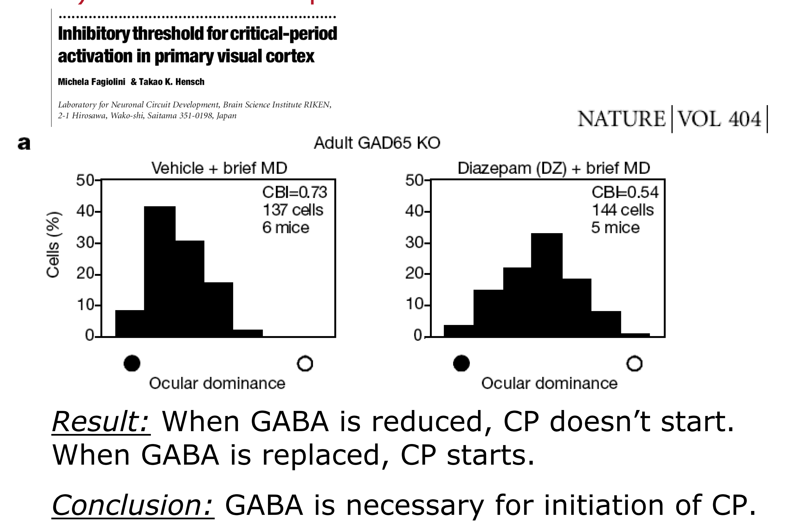
Functional Inhibition: GABA
GABA = Inhibitory NT.
GABA is required for Critical Period (CP), and GABAergic activity initiates CP.
BUT! GABA +- cannot Reopen CP in adult.
Diazepam /Valium -> + GABA

Slide 19
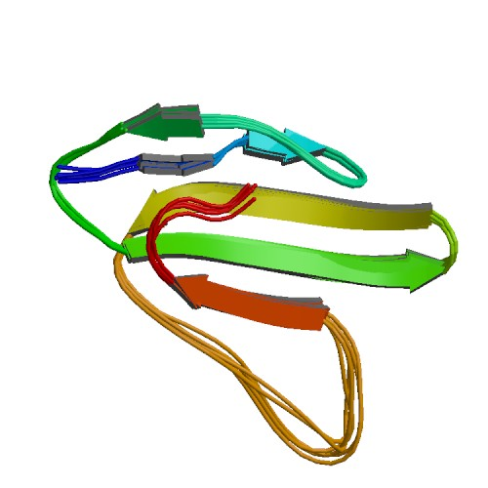
Lynx1 brakes Plasticity in the Adult Cortex
Acetylcholine Antagonist.
Binds to Ach receptors.
ToLIP (Toxin Like Protein)
Morishita, Hensch, et al’. “Lynx1, a cholinergic brake, limits plasticity in adult visual cortex”. Science (2010).
“Lynx for braking plasticity”. Science (2010).

Slide 20
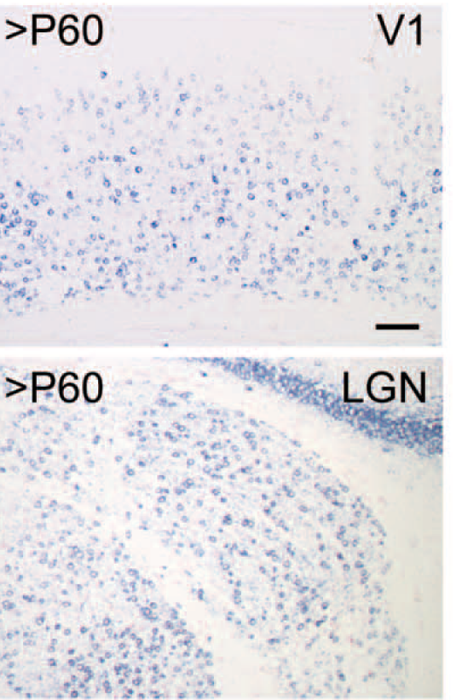
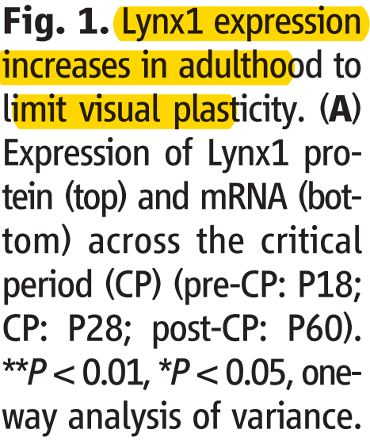
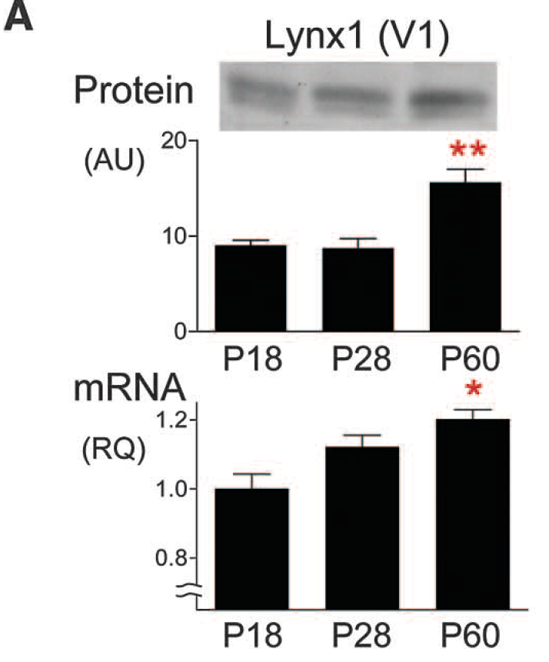
Lynx1 brakes Plasticity in the Adult Cortex
Morishita, Hensch, et al’. “Lynx1, a cholinergic brake, limits plasticity in adult visual cortex”. Science (2010).

Slide 21
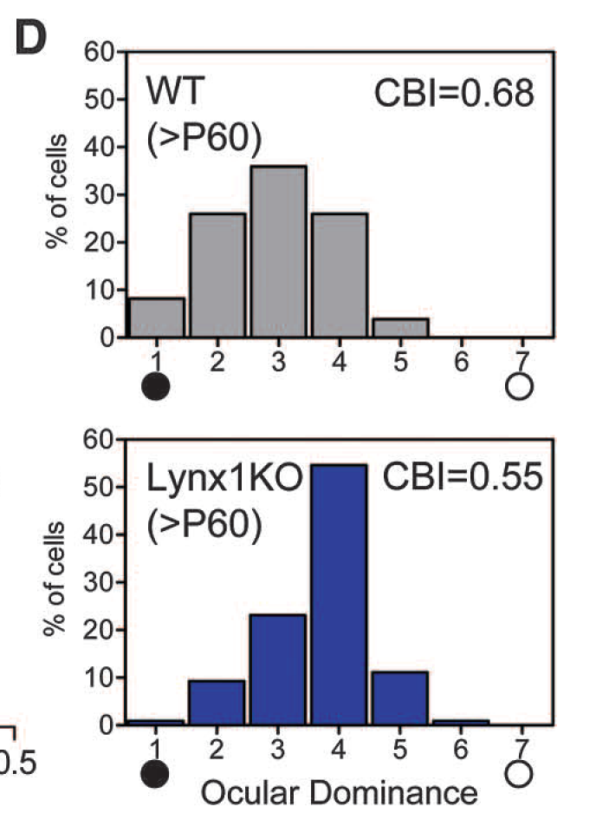
Lynx1 brakes Plasticity in the Adult Cortex
( D ) Short-Term Monocular Deprivation shifts the ocular dominance distribution of Lynx1 knock-out (KO) mice [bottom], but not in wild-type (WT) mice.

Slide 22
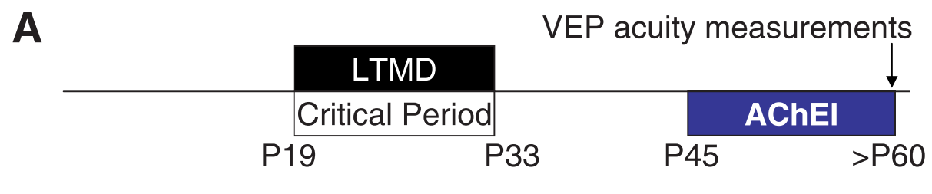
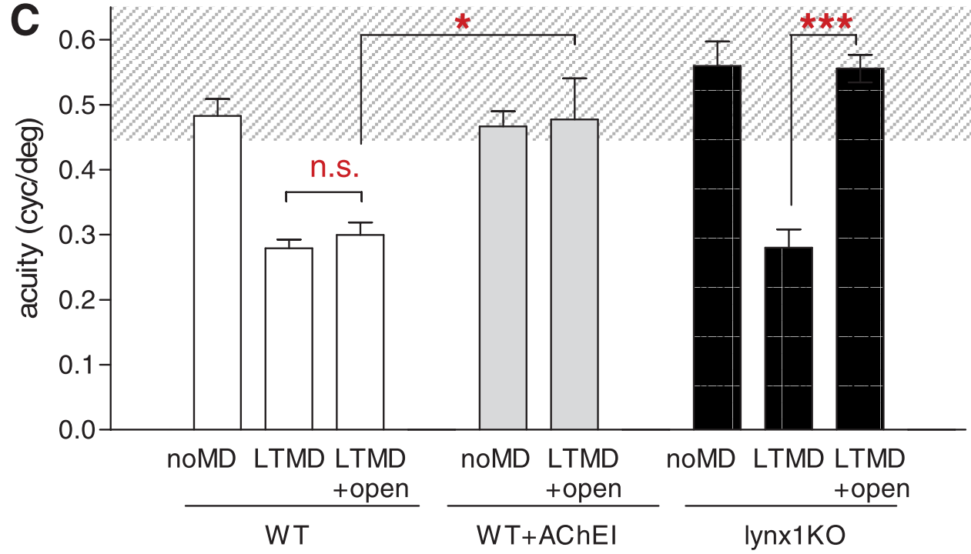
Lynx1 KO reopens Critical Period Plasticity in the Adult visual Cortex
Fig. 3. Recovery from amblyopia in Lynx1 KO mice.
( A ) After long-term MD (LTMD) spanning the critical period, the deprived eye was reopened & VEP (visual evoked potential) acuity was measured in V1.
( C )Visual acuity in WT mice (white) without deprivation [no MD] decreases after LTMD spanning CP and endures. Reopening the deprived eye together with Ach inhibitor (AChEI) restores vision.
Lynx1 KO mice (black bars) spontaneously recover from LTMD simply by reopening the deprived eye to reach normal levels.

Slide 23

Functional Stabilization:
$$\frac{Excitation}{Inhibiton}$$
Excitation/Inhibiton
GABA
LYNX1
More Factors:
(HDAC – Histone-Deacetylase..)
Notes:
(GABA), chief inhibitory neurotransmitter
Ach - acetylcholine. HDAC – Histone-Deacetylase

Slide 24
Conclusions:
Default state is plastic, not stable.
Stable state is maintained by molecular brakes. (Lynx1, others).
E/I ratio important to critical period “timer” activation.
Don’t confuse Critical and Sensitive periods!
Many more factors to discover?
MASSIVE clinical potential.

Slide 25


